Slide 1
JDBC Project Inventory Management System (car showroom)
Submitted To
Md Moshaidul Islam
Consultant : J2EE IDB-BISEW
Submitted By
Md Mostafizur Rahman
Trainee Id: 1243560
Batch Id: j2ee/ccsl-m/37-1

Slide 2
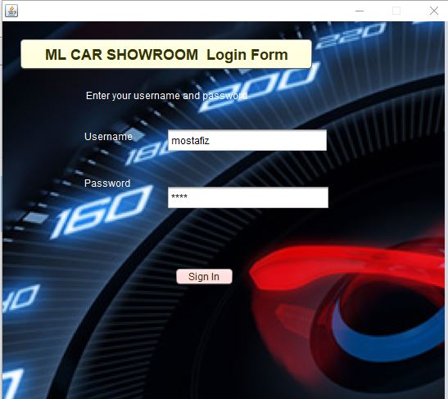

Slide 3
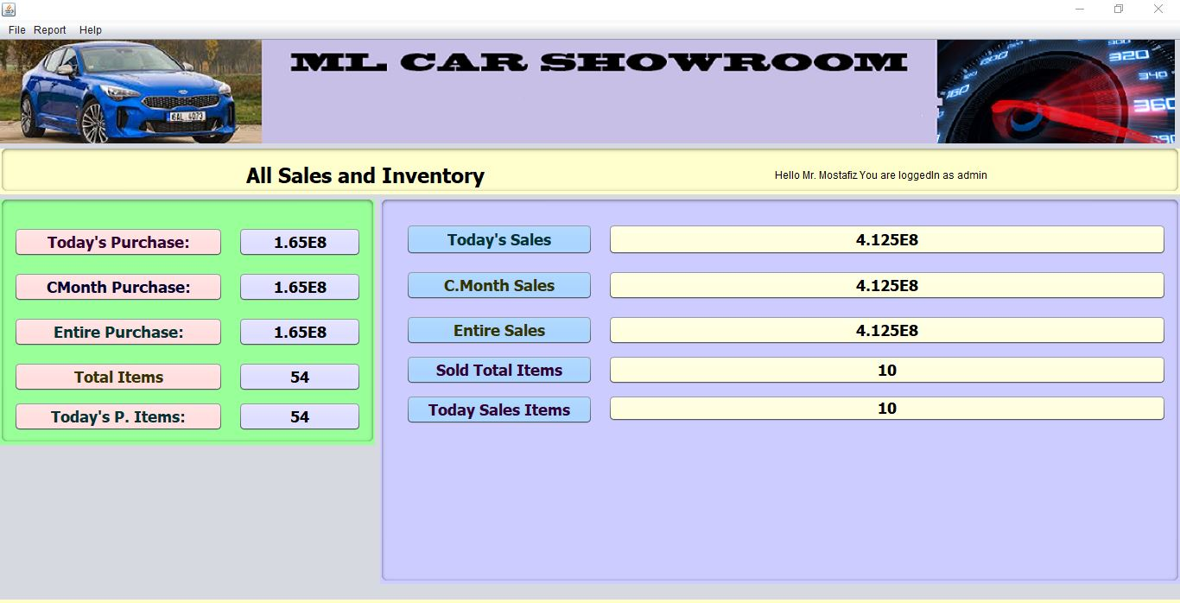
Purchase and Sales Report

Slide 4
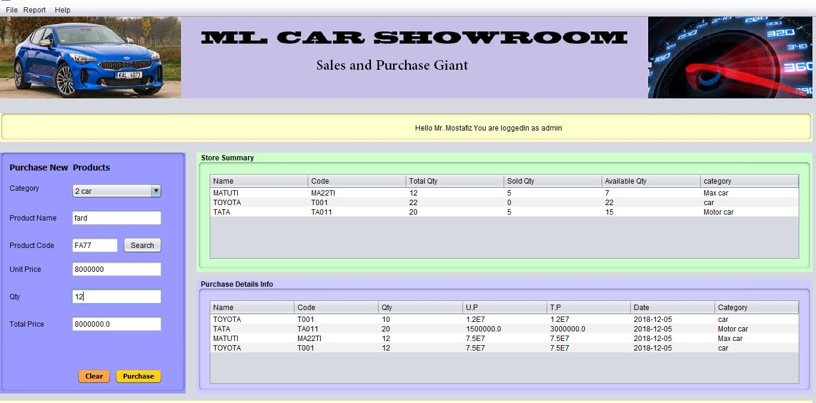
Purchase

Slide 5

After Purchase

Slide 6
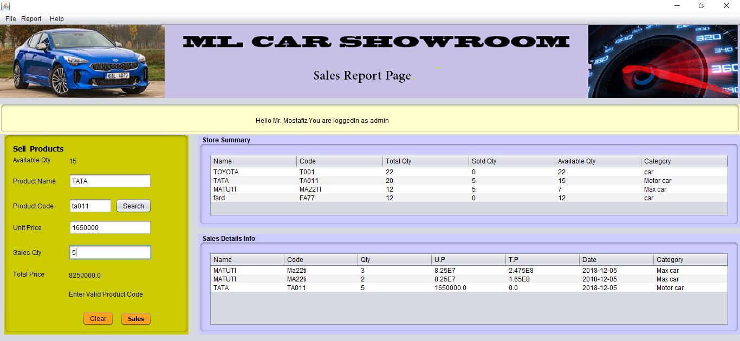
Sales

Slide 7
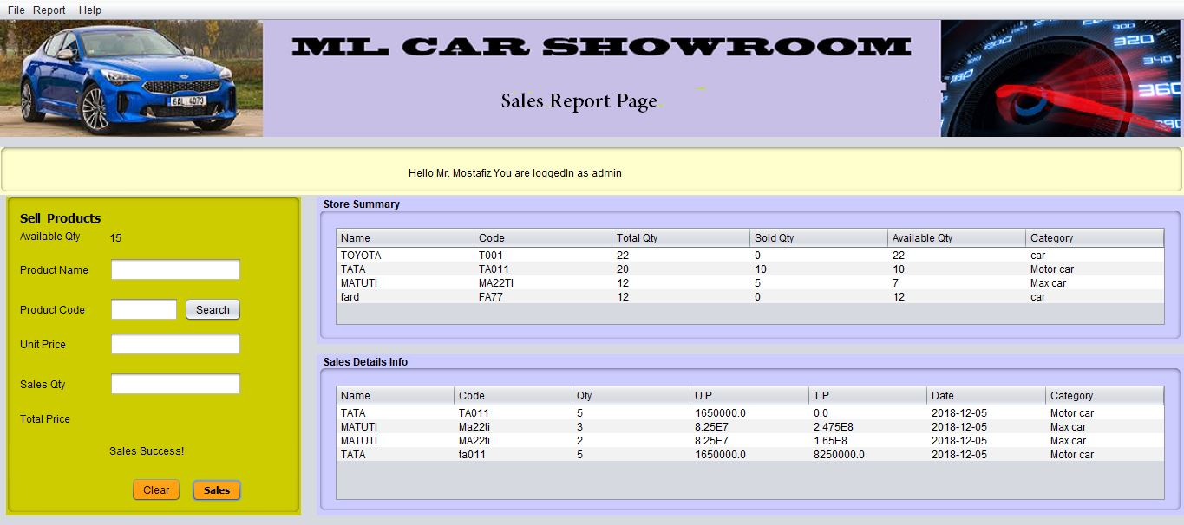
After Sales

Slide 8
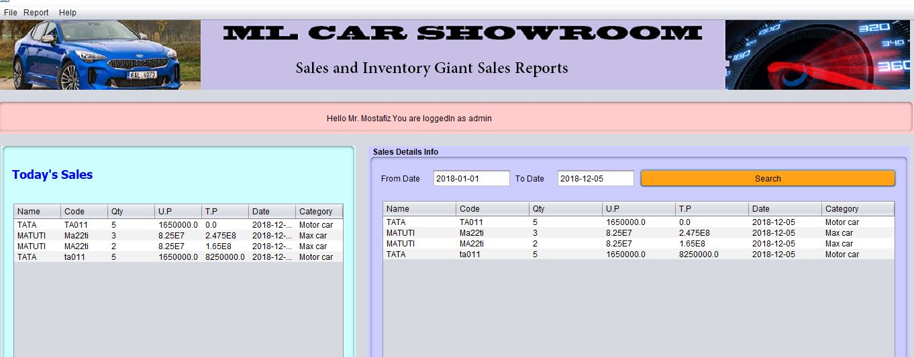
Sales Report

Slide 9
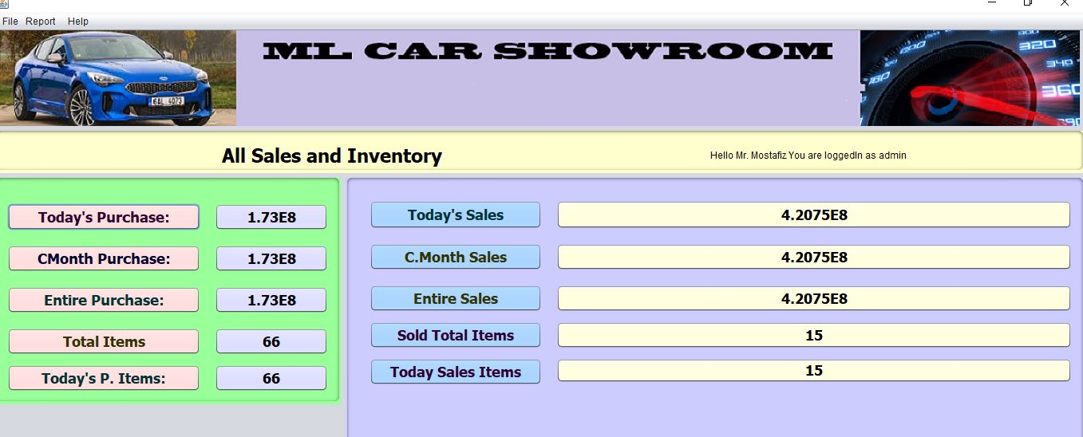
Summary

Slide 10
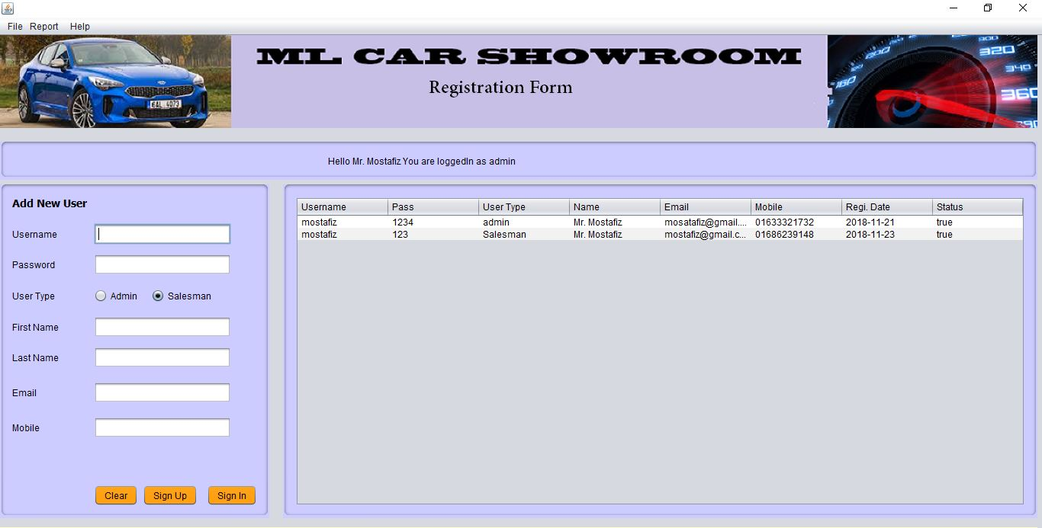
User Registration Rorm

Slide 11
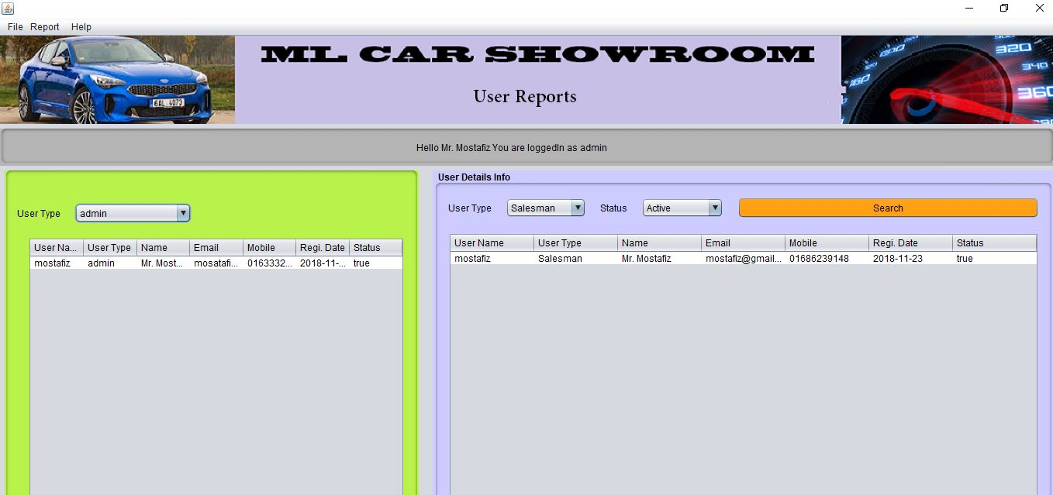
User Report

Slide 12
Thank You Sir

